Slide 1
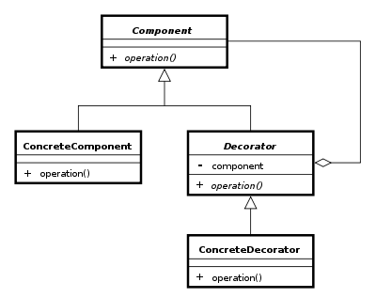
The Decorator pattern
Group 4 Asger Breinholm, Mathias Brændgaard and Robin Bertojo

Slide 2
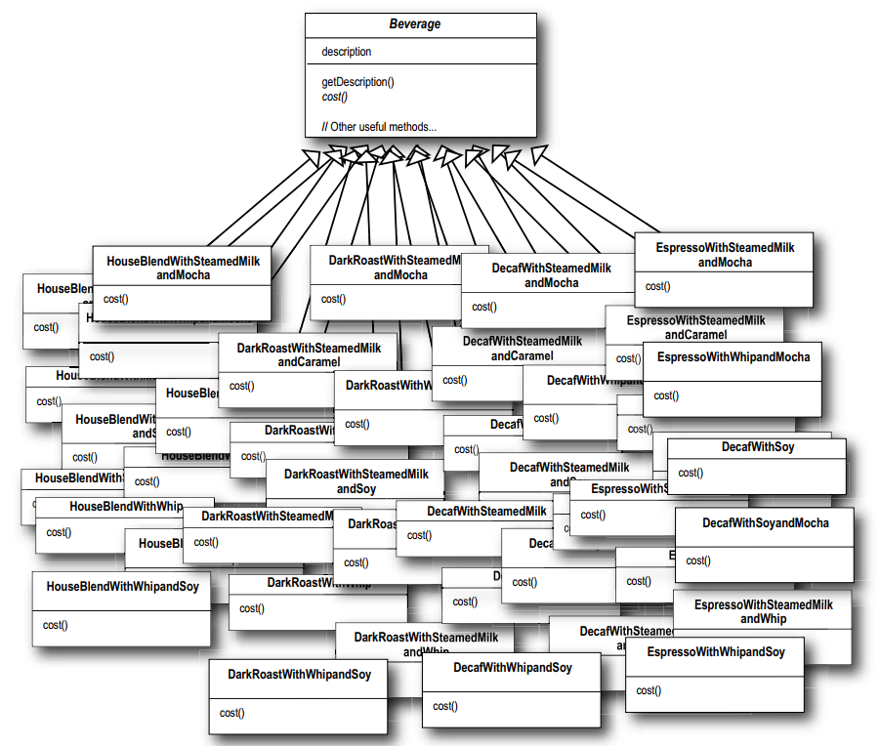

The problem
Subclass everything
class DarkRoastWithMilkAndSugar{
return GetDescription;
}
class EspressoWithSugar{
return GetDescription;
}
Etc.
* Head First, Design Patterns – Eric Freeman and Elisabeth Freeman with Kathy Sierra and Bert Bates

Slide 3

The solution – with Decorator
Extension at runtime
class DarkRoast : ICoffee{
GetDescription() => ”Dark Roast”;
}
class Milk : Condiment{
GetDescription() => base. GetDescription() + ” with milk”;
}
class Sugar : Condiment{
GetDescription() => base. GetDescription() + ” with sugar”;
}
ICoffee bev = new Sugar(new Milk(new DarkRoast()))
bev. GetDescription()
This then makes ”Dark Roast” + ” with milk” + ” with sugar” = ”Dark Roast with milk with sugar”
Saves could you from writing a lot of code

Slide 4
Pros & cons
Pros:
Fewer subclasses
Add at run time
Any number
OCP
SRP
Cons:
More complex undo
Can impact execution time

Slide 5
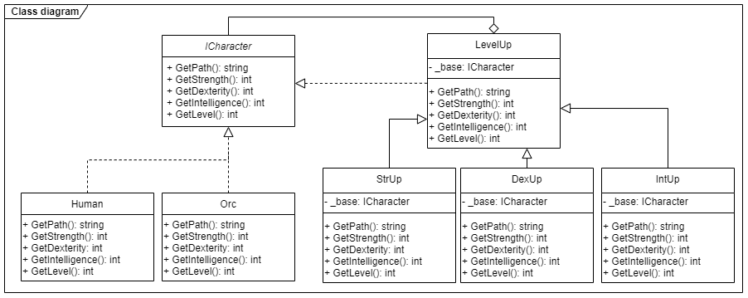
Class diagram

Slide 6
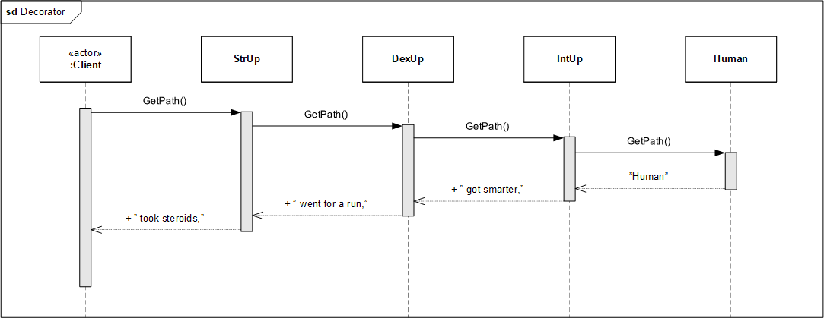
Sequence diagram

Slide 7
Our implementation
LevelUp base:
The decorator StrUp who inherits:

Slide 8

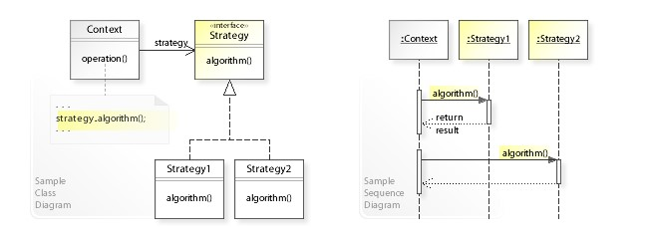
Comparison
Adaptor
Strategy

Slide 9
Conclusion
Good for combining behaviour
Not particularly good for decision making
Try to keep it at a minimum

